Slide 1

Reddit & Instagram for #scicomm
Karla Arboleda
Social Media Specialist

Slide 2
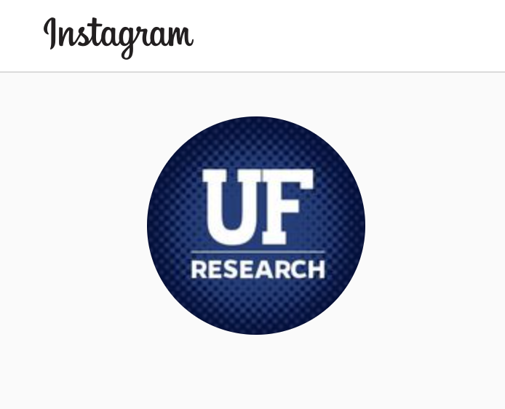

Overview
Reddit AMAs
  About
  How-to
  Audience
  Internal/external reach
Instagram
  Visual opportunities
  Complementary to other platforms

Slide 3
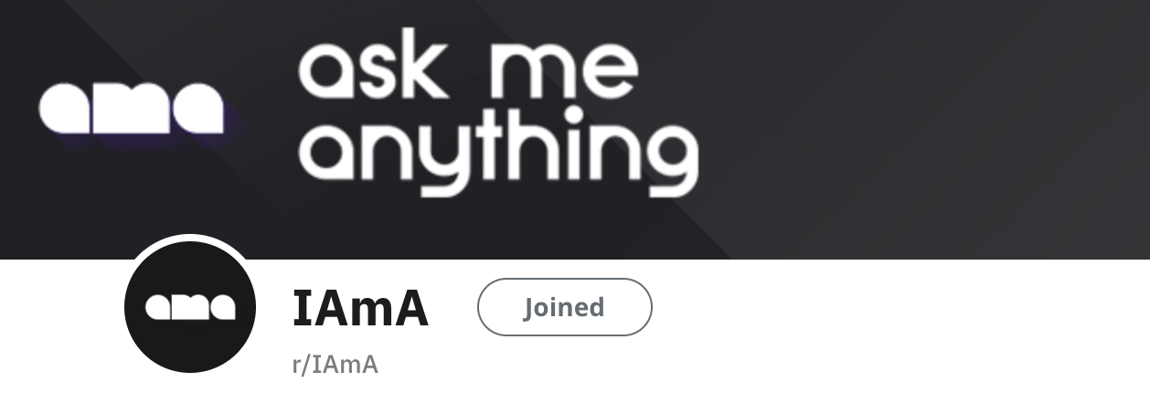
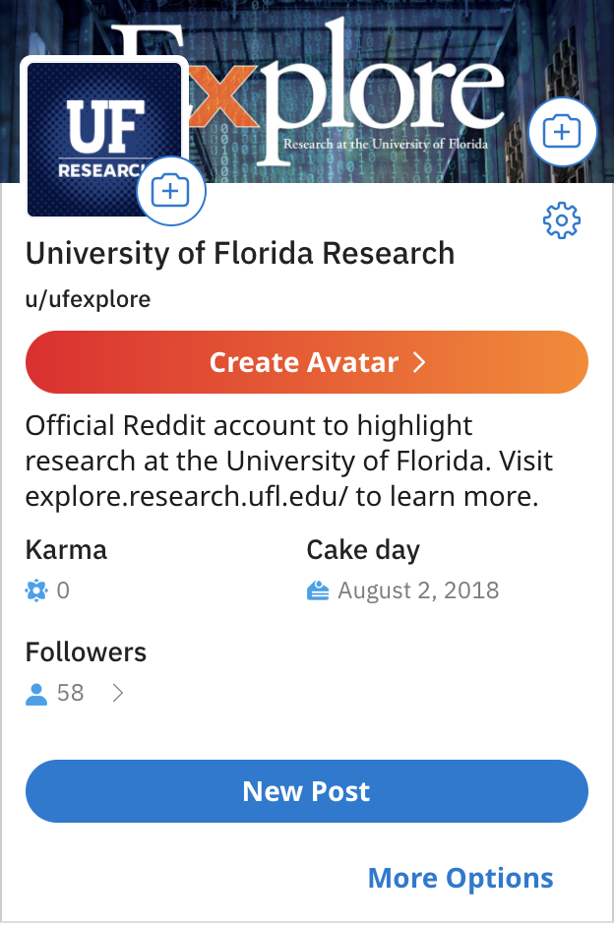
u/ufexplore
Large online community
Threads
Notes:
Not necessarily a platform to get followers, but to get engagement
Opportunity to reach those who are otherwise not part of your institution’s circle
Threads for many different things – Advice, questions, discussion, humor, news and QUESTIONS!
Host an “AMA” with one of your researchers to answer questions from different people
Write a biography with supporting links, reach out to moderators to schedule a day and time, and moderate between the expert and the audience

Slide 4
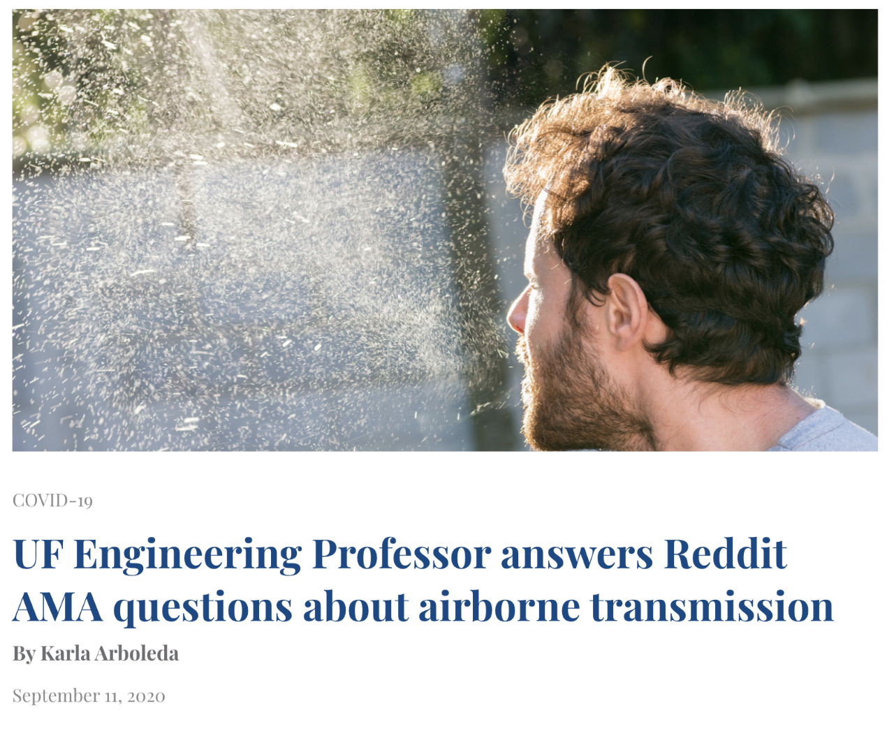
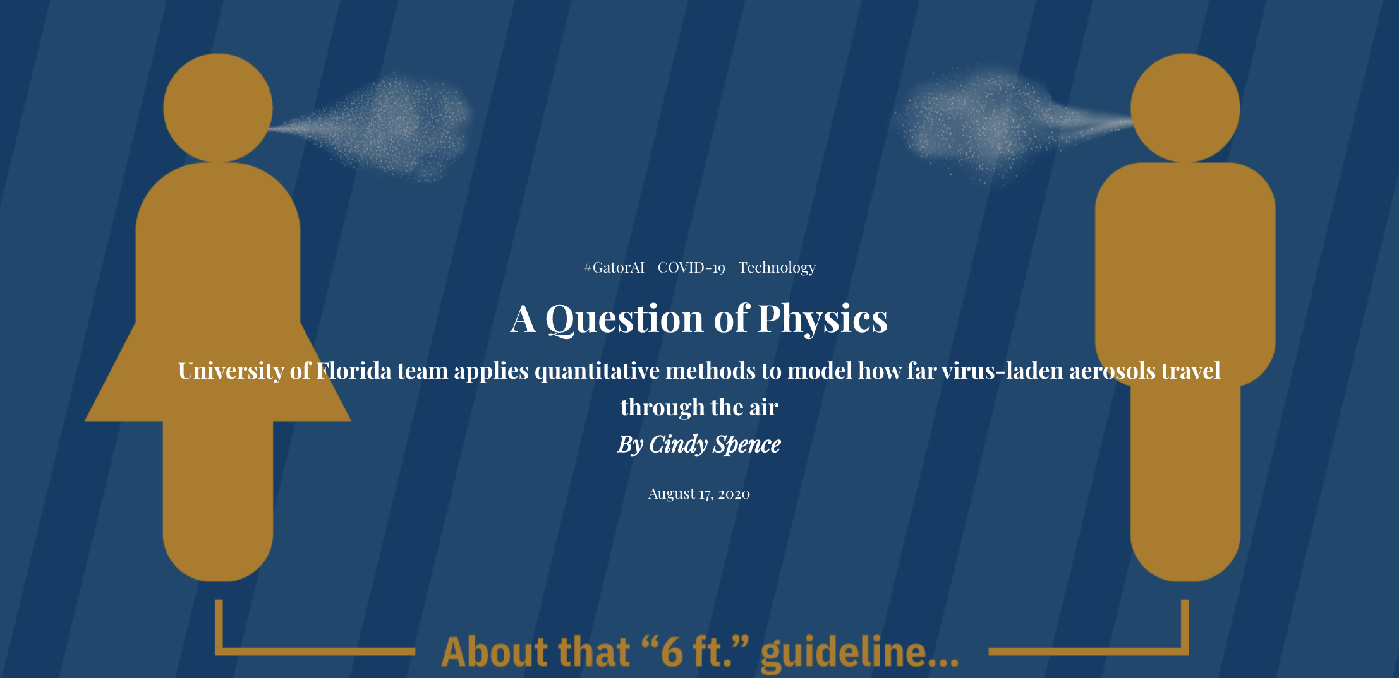
How-to
What’s news?
Coordination
Sub-threads
Notes:
What’s the latest at your university research magazine? Do you have an expert who can answer questions on a topic that’s buzzing in the news? Did they do something cool recently?
Work with your researcher to schedule a day and time also with the moderators of a thread
On the day of, post the AMA to different subreddits
Example: Reddit AMA with Bala Balachandar a mechanical and aerospace engineering professor studying how far aerosols travel in relation to COVID (https://www.reddit.com/r/askscience/comments/ipdr16/askscience_ama_series_i_am_an_engineering/)
Top right image: Reddit AMA recap article that was featured in the Gainesville Sun local newspaper (https://explore.research.ufl.edu/uf-engineering-professor-answers-reddit-ama-questions-on-airborne-transmission.html)

Slide 5
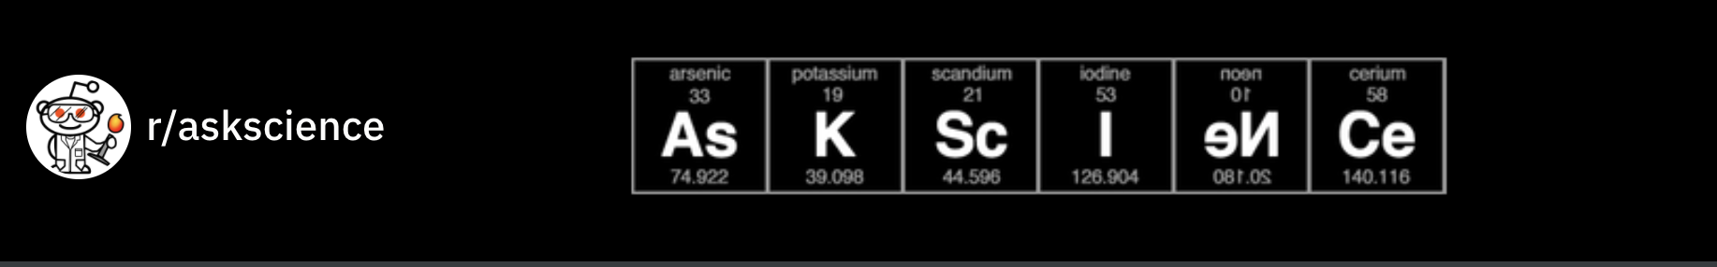
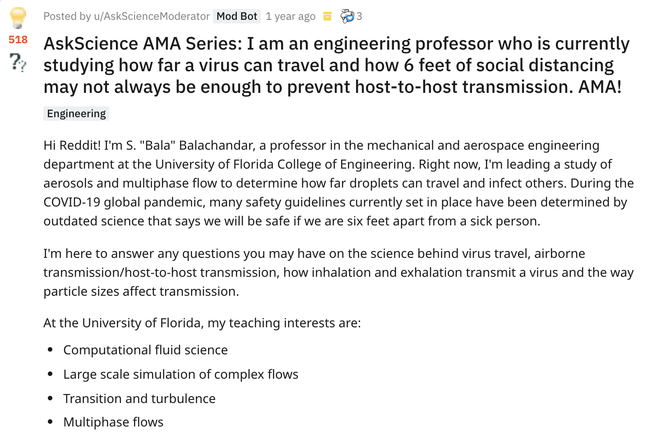
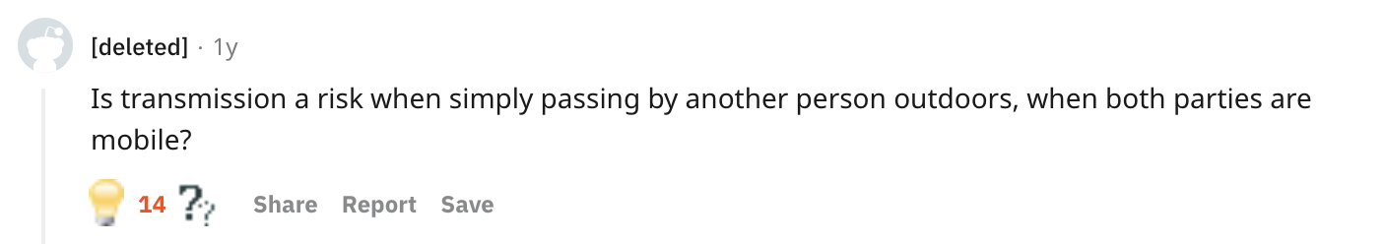
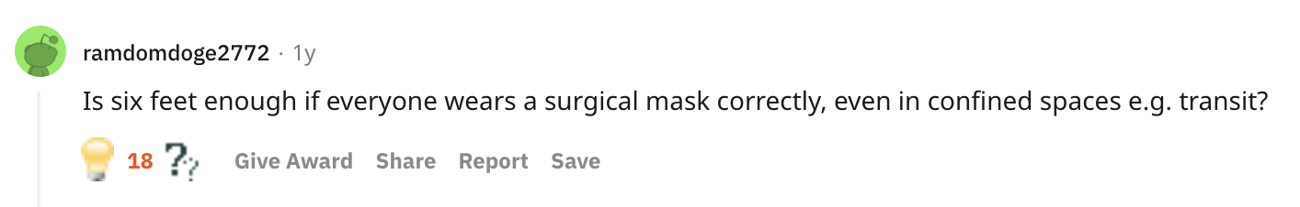
Notes:
Example of Bala Balachandar’s AMA and questions from people
Top image: r/AskScience thread that is good for AMAs
Remember the goal for your expert is to answer as many questions as thoroughly as possible

Slide 6
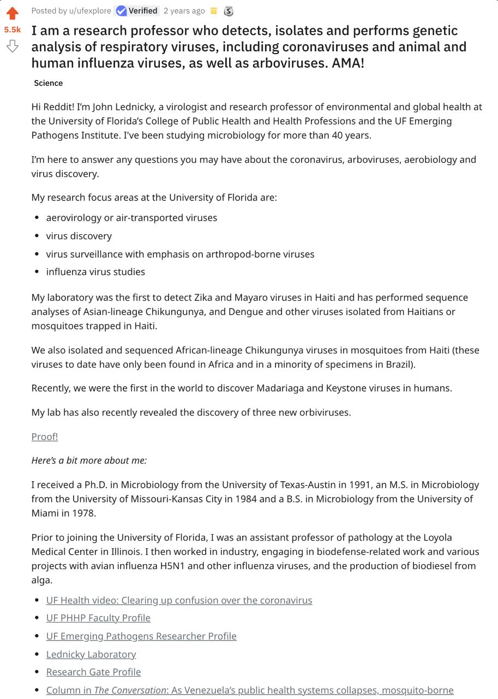
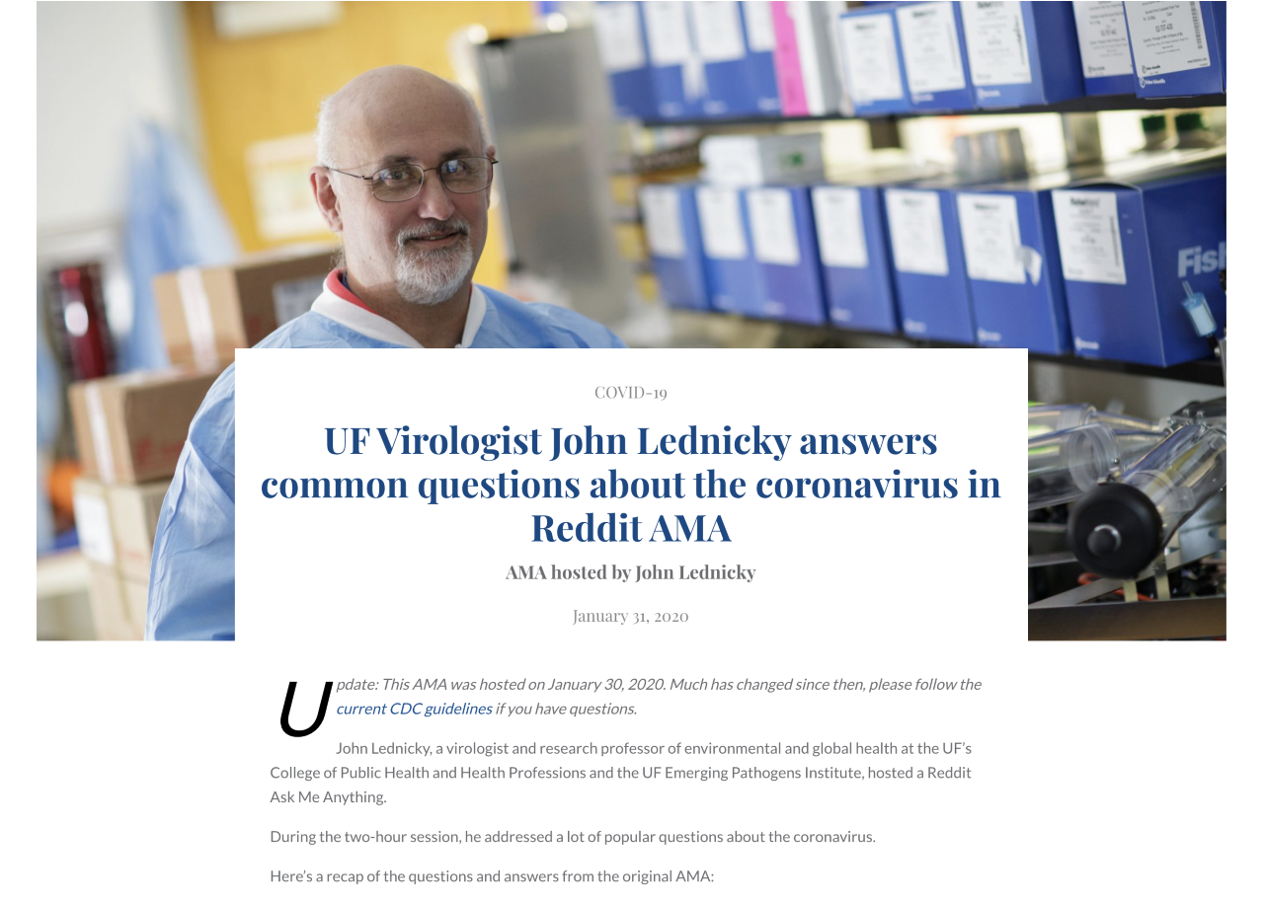
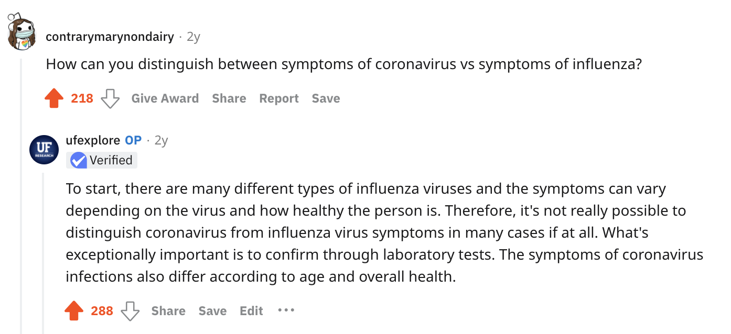
Timely – Coronavirus AMA
Notes:
Reddit AMA with John Lednicky: https://www.reddit.com/r/IAmA/comments/ew6jfh/i_am_a_research_professor_who_detects_isolates/
Recap of Reddit AMA: https://explore.research.ufl.edu/uf-virologist-john-lednicky-answers-common-questions-about-the-coronavirus-in-reddit-ama.html
Most engaging AMA with 5.5K upvotes and 733 total comments

Slide 7
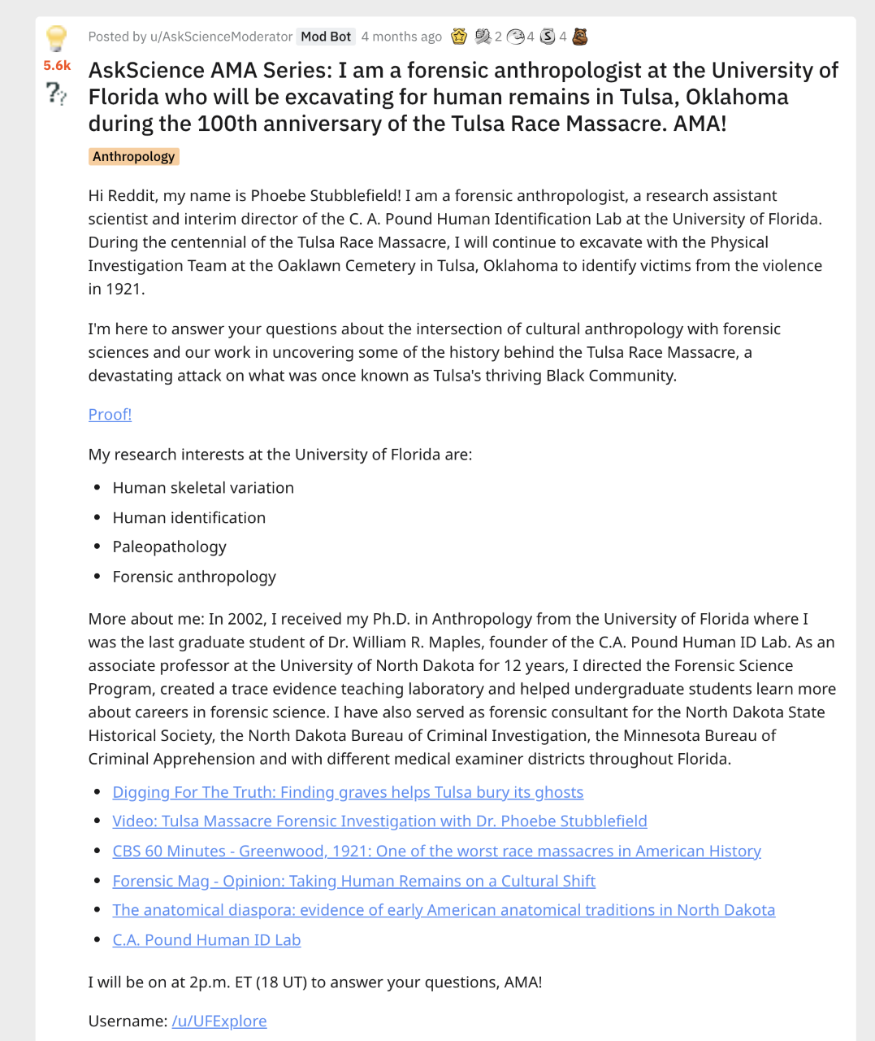
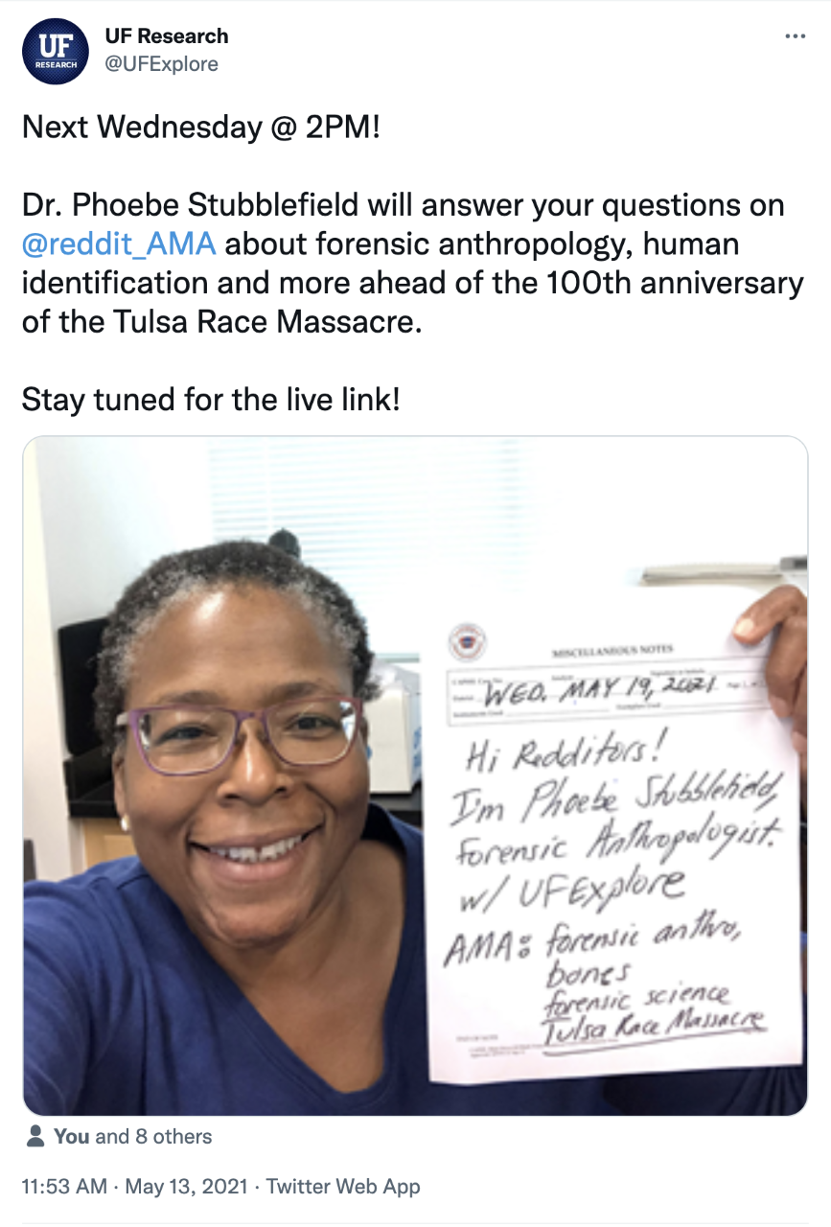
Timely – Tulsa Massacre Centennial
Notes:
- Reddit AMA with Phoebe Stubblefield: https://www.reddit.com/r/askscience/comments/ng2q1g/askscience_ama_series_i_am_a_forensic/
Recap of Reddit AMA with Phoebe Stubblefield: https://explore.research.ufl.edu/uf-forensic-anthropologist-answers-questions-about-tulsa-race-massacre-on-reddit-ama.html
Most highly rated AMA with 5.6K upvotes, 12 community rewards and ~70 questions answered by Stubblefield

Slide 8
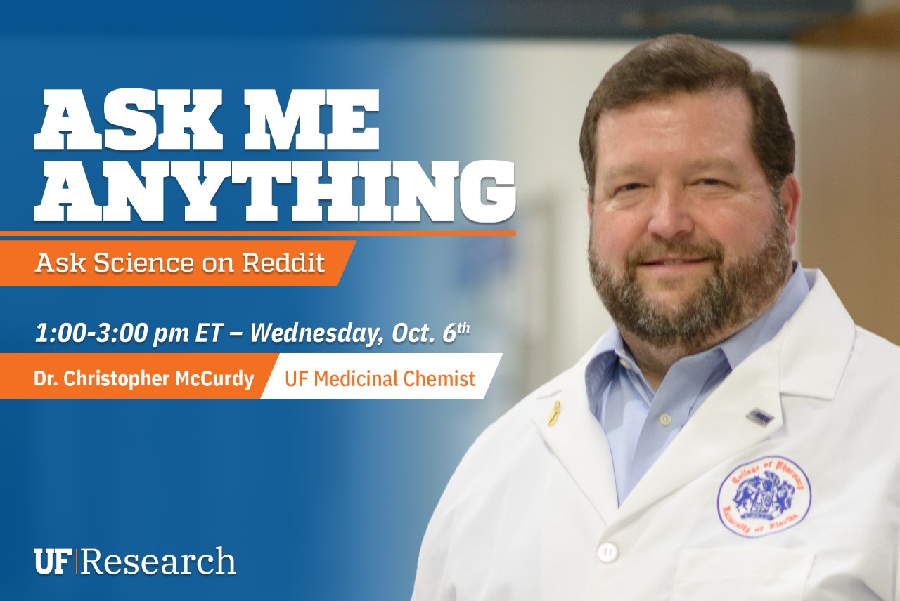
Kratom AMA – October 6th
1 – 3 p.m.
Notes:
Future AMA on 10/6/2021 with Dr. Christopher McCurdy

Slide 9
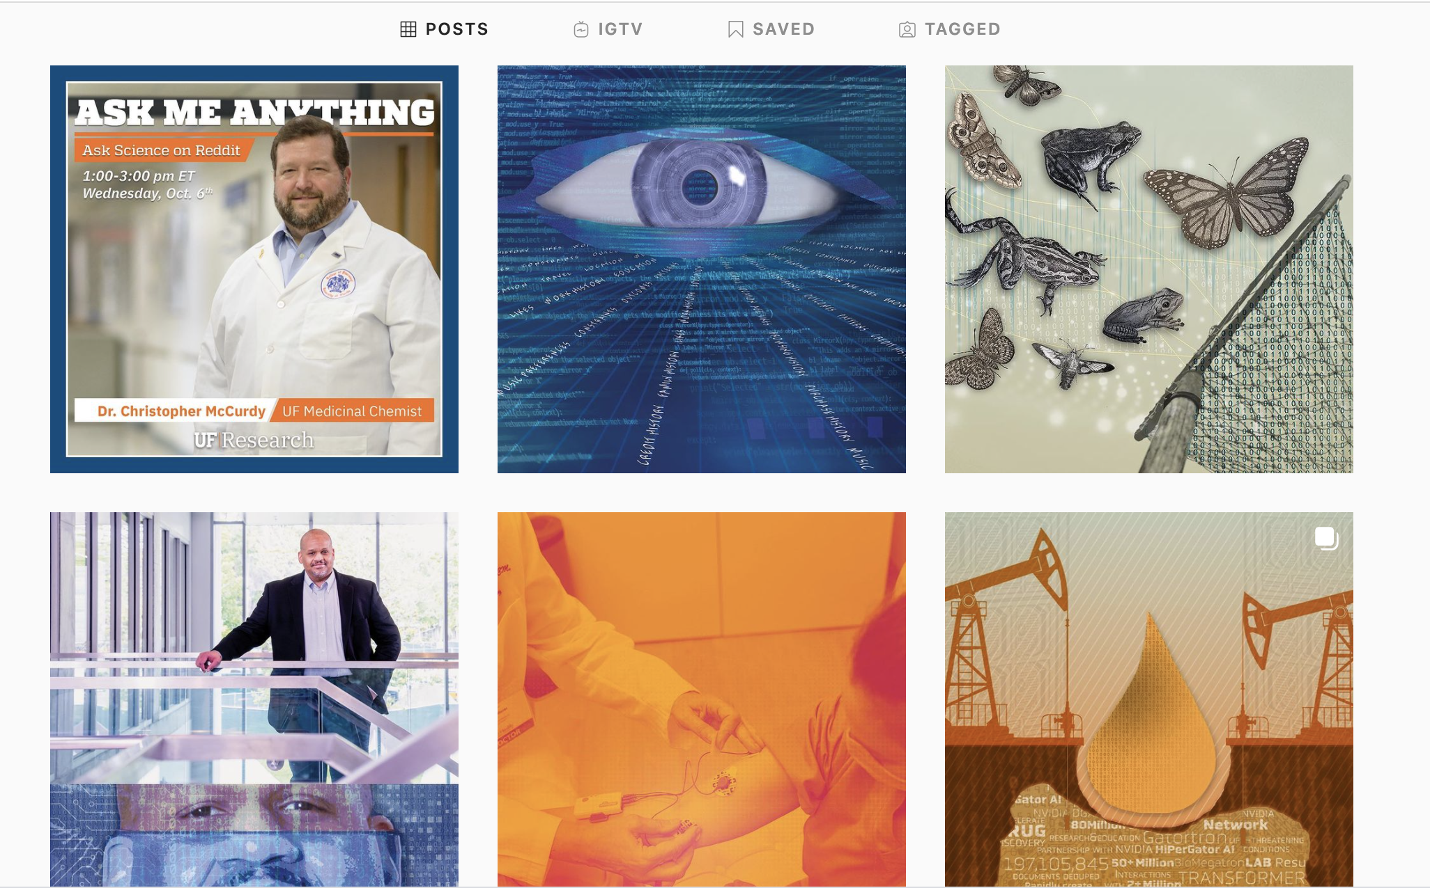
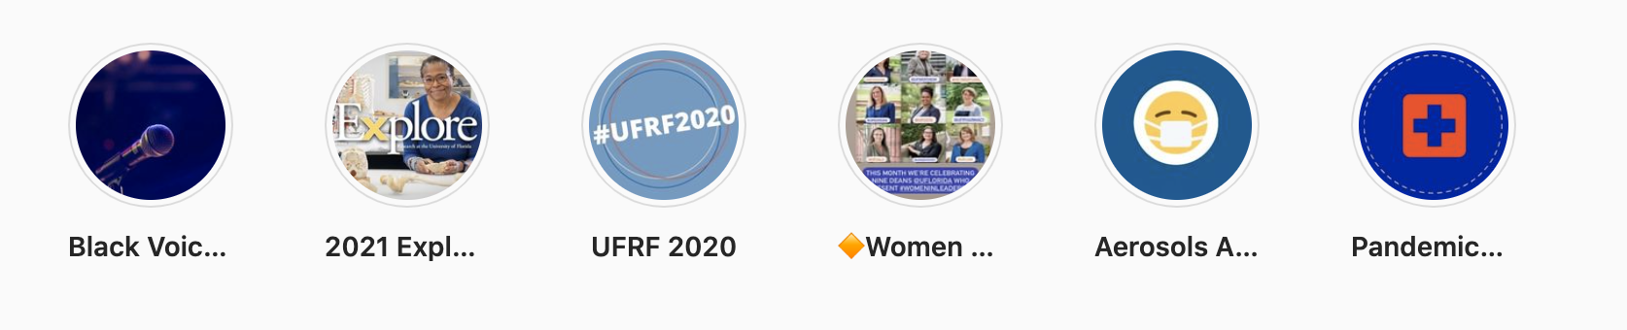
Instagram
@UFExplore
Visual opportunities
Stories/Highlights
Internal

Slide 10

Using algorithms
More than hashtags
Interacting is KEY!
Notes:
• Spend a little extra time after every post trying to engage with posts similar to yours. Click through hashtags and give other posts a like, a save or maybe a comment
• Instagram has let it be known that interacting with a post will feed their algorithm to show you more
• Heart – Tap this to like a post. This doesn’t boost your effort as much as others, but certainly puts your account name in one more place.
• Speech bubble — Comment on a post on accounts that are similar to yours. You can comment on anyone’s, obviously, but excessive interactions can get you flagged as a bot.
• Paper plane – Share your own posts on your stories or relevant posts from others.
• Bookmark – Save a post to your ‘bookmarks’ section. This is the easiest way to play with algorithms and boost your account. It shows the algorithms you like that post and will now associate your posts with theirs (perhaps to new IG users who don’t already follow you or in the Explore page)

Slide 11
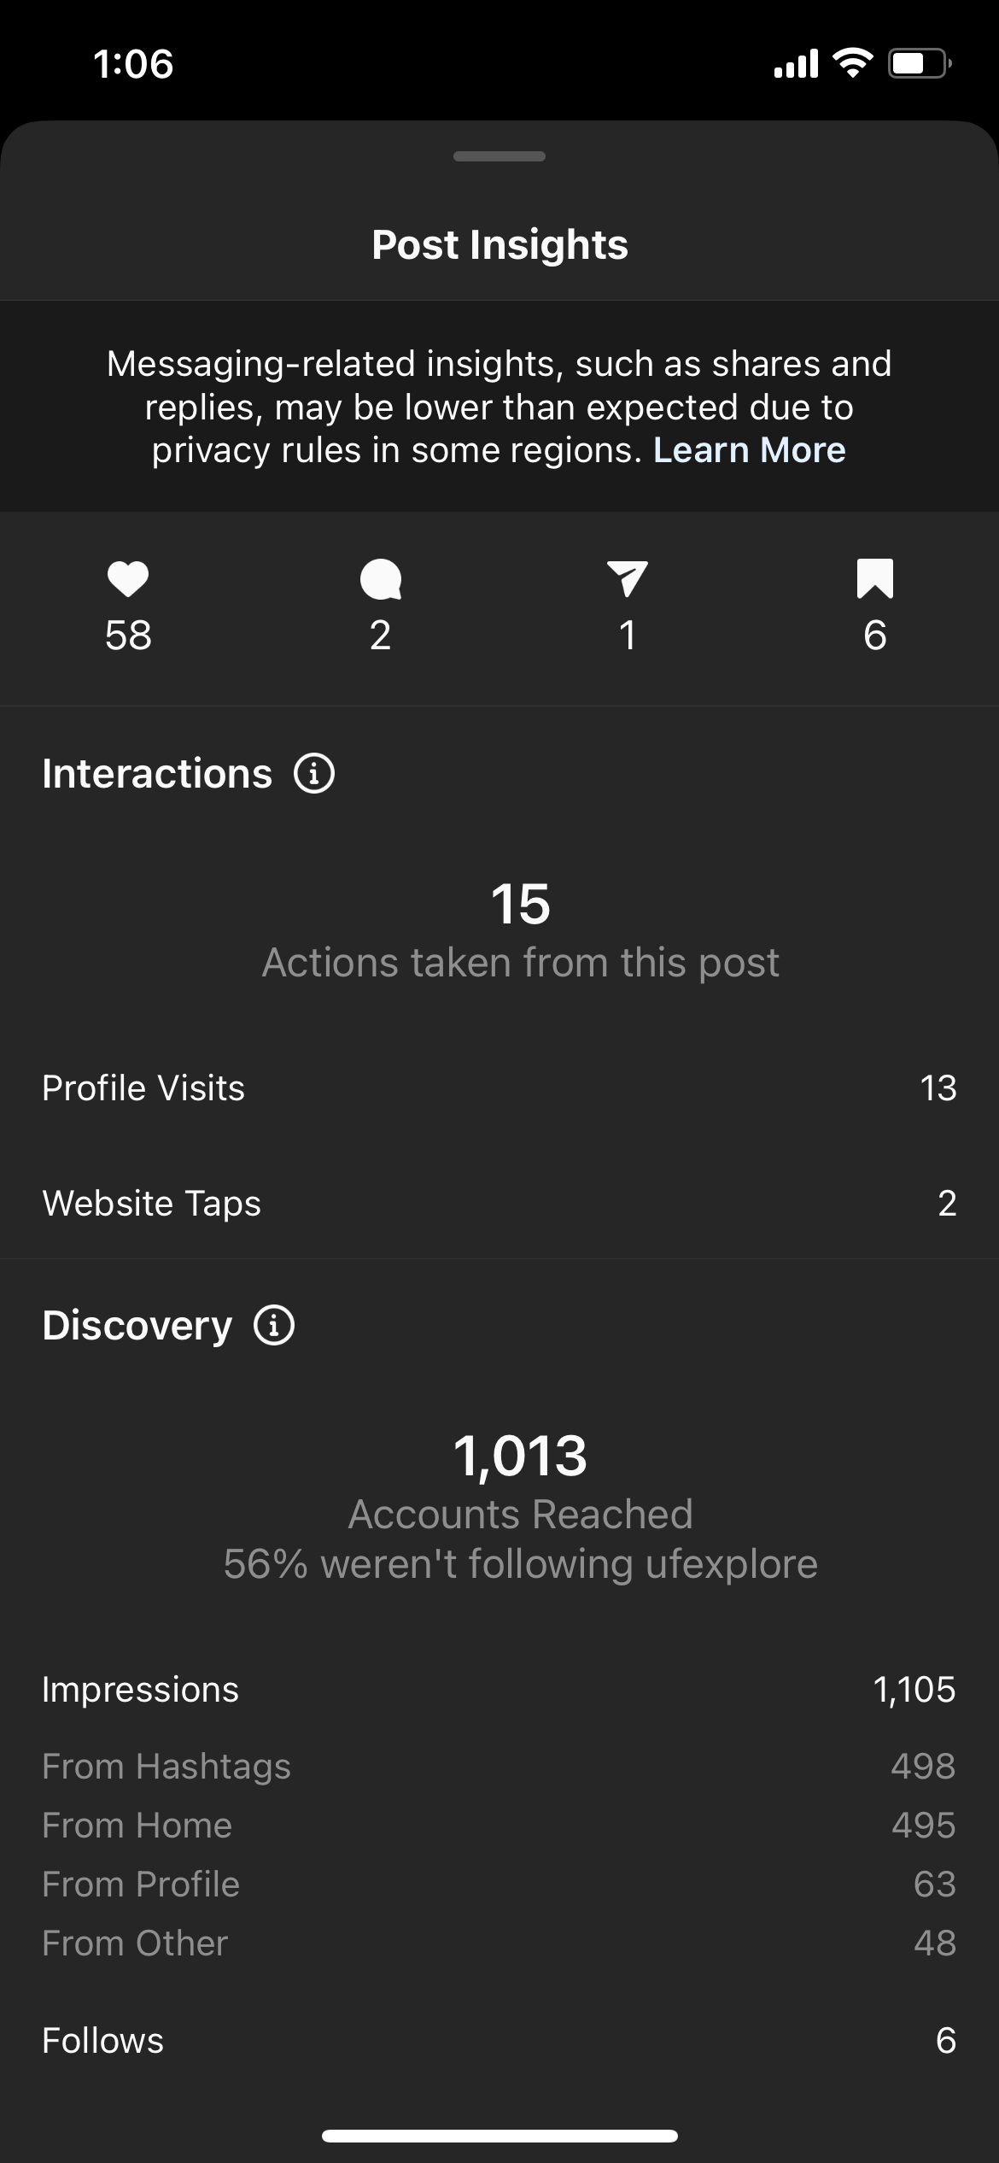
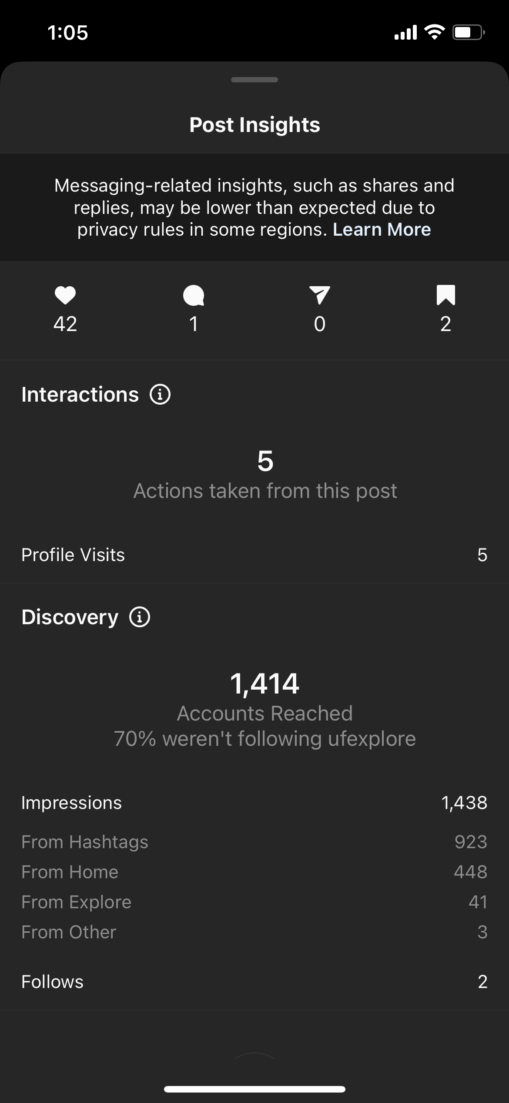
Insights

Slide 12
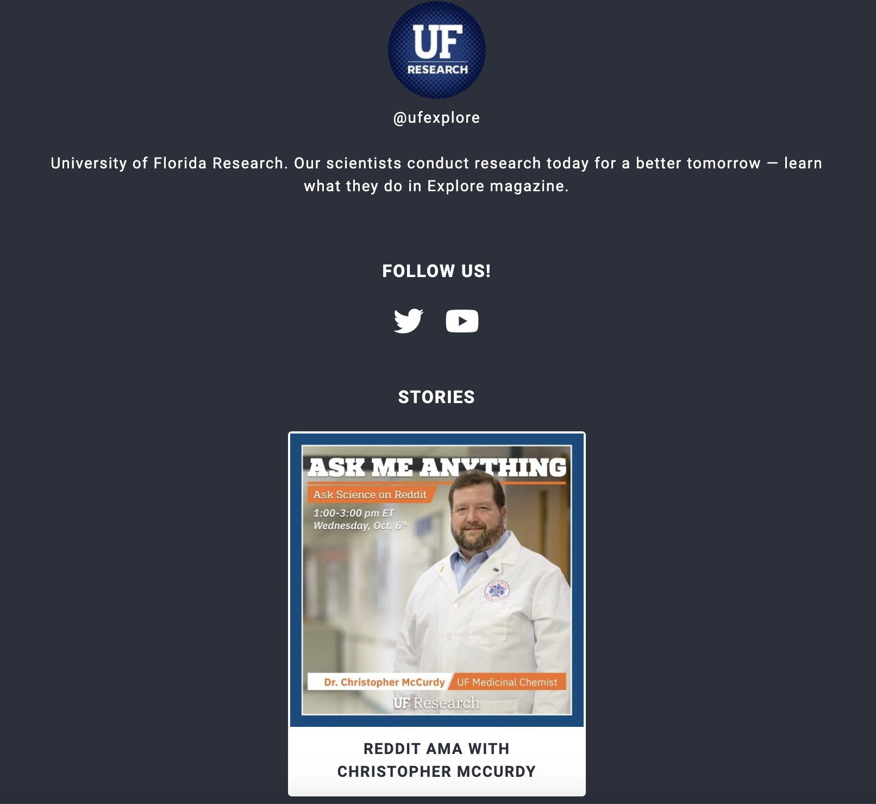
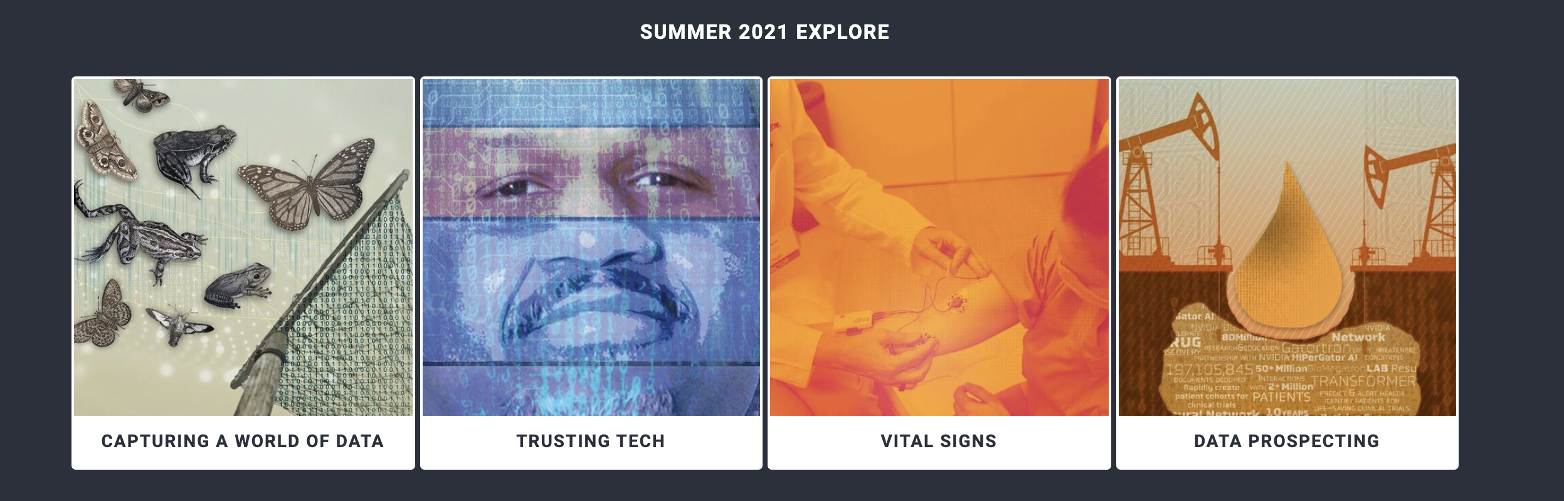
Link in bio
• Link back to your content
• Update fresh stories
Notes:
• lnk.bio is a good way to put links back to your content and redirect people to your website! Another one is LinkTree

Slide 13
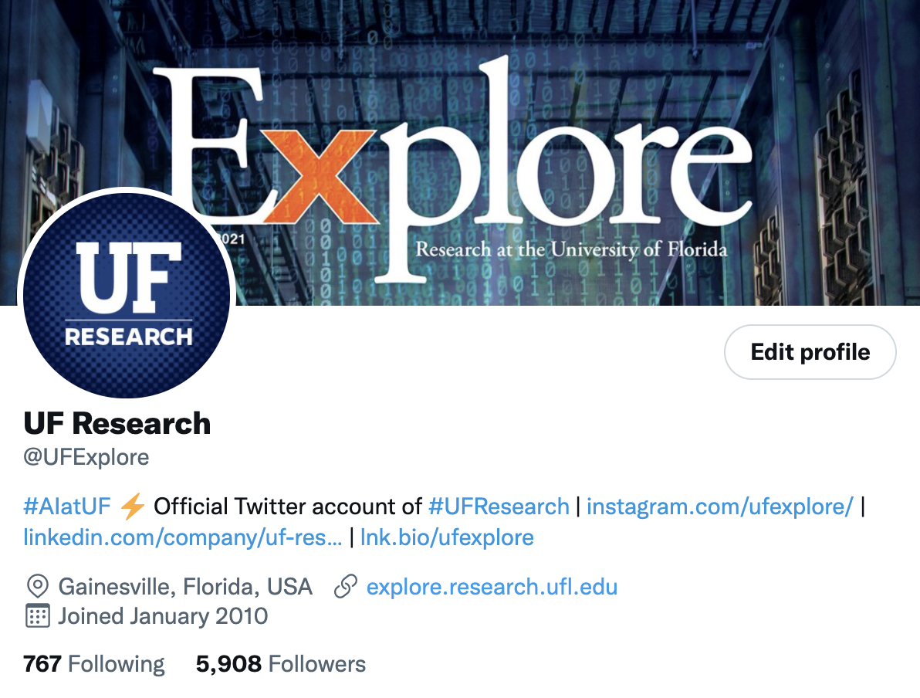
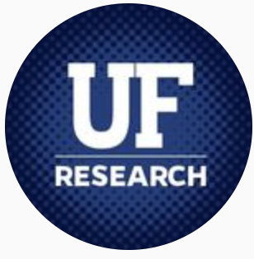
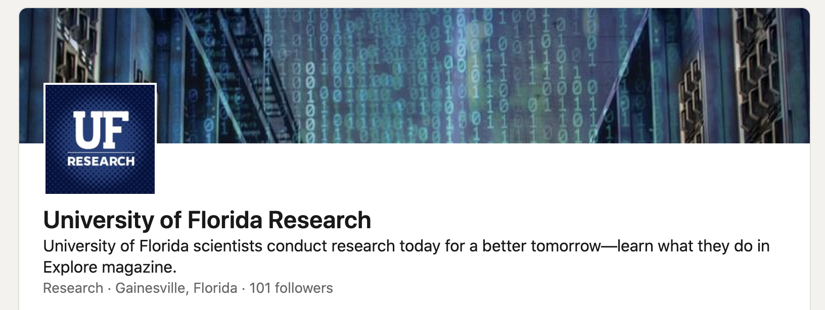
Thank you!
Twitter: @UFExplore
Instagram: @UFExplore
LinkedIn: University of Florida Research

