Slide 1

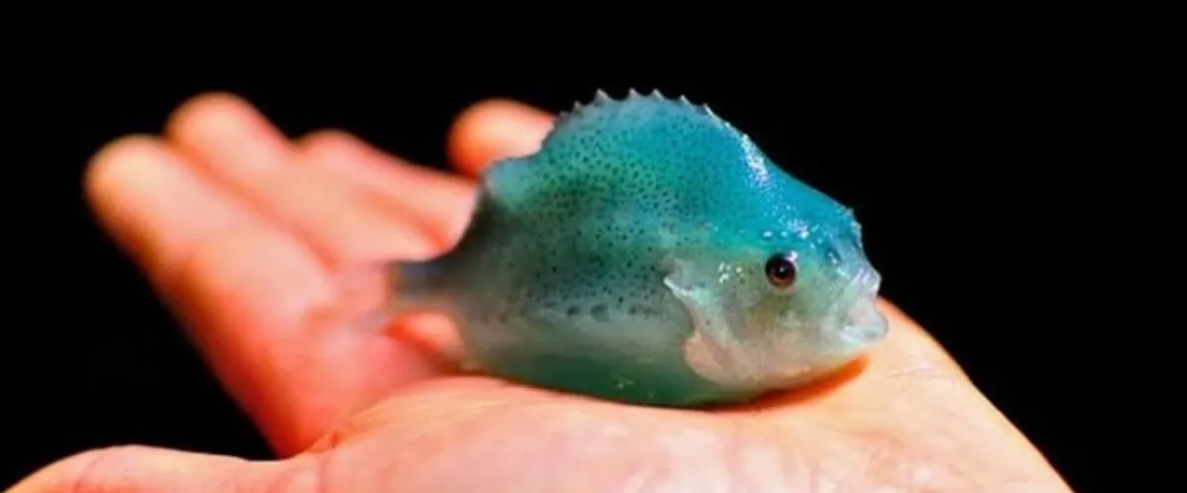
Tiktok: More than just dancing videos
Nathaniel Spada – MS at the University of NH
TikTok: @Spadaniel44
Email: nns1003@wildcats.unh.edu

Slide 2
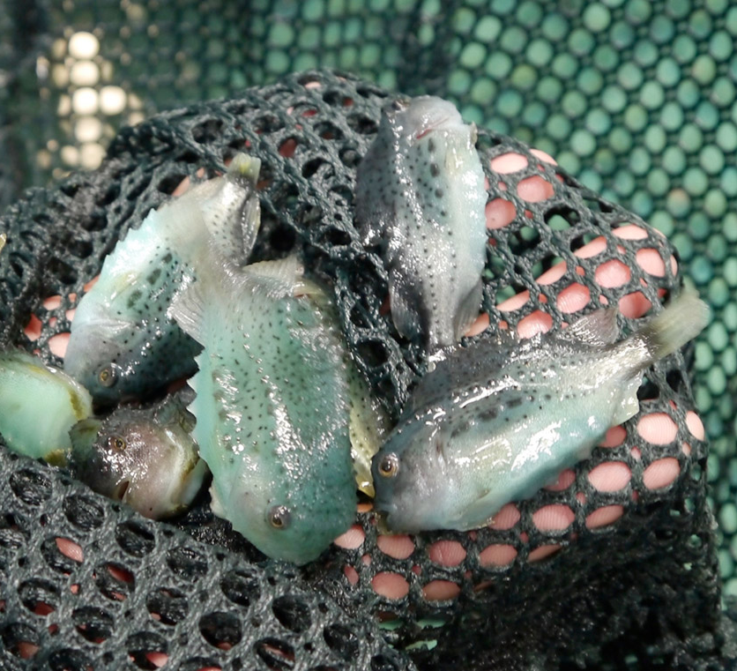
My Research
Dr. Elizabeth Fairchild’s Lab
Lumpfish Aquaculture
Lumpfish as sustainable pest controllers
UNH – first major producer of lumpfish in the US

Slide 3
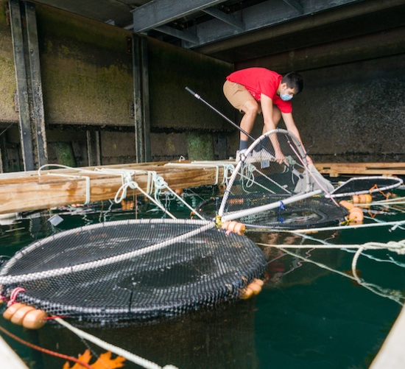
Who is Spadaniel44?
1.7 million followers on TikTok
27.9 million likes accumulated
Started on 7/16/2020
First viral video on 8/19/2020
My goal: to present my research and the research of my colleagues in a fun and exciting way that’s understandable for all audiences

Slide 4
Timeline
8/19/2020 (4.6M views, 824.7K likes) https://www.tiktok.com/@spadaniel44/video/6862896690899258630?lang=en&is_copy_url=0&is_from_webapp=v1&sender_device=pc&sender_web_id=6941060622831175174
11/12/2020 (9.8M views, 1.6M likes) https://www.tiktok.com/@spadaniel44/video/6894382658047053061?lang=en&is_copy_url=0&is_from_webapp=v1&sender_device=pc&sender_web_id=6941060622831175174
2/4/2021 (896.2K views, 69.2K likes) https://www.tiktok.com/@spadaniel44/video/6925575704872619270?lang=en&is_copy_url=0&is_from_webapp=v1&sender_device=pc&sender_web_id=6941060622831175174
9/11/2021 (5.7M views, 711K likes) https://www.tiktok.com/@spadaniel44/video/7006466269146860806?lang=en&is_copy_url=0&is_from_webapp=v1&sender_device=pc&sender_web_id=6941060622831175174

Slide 5
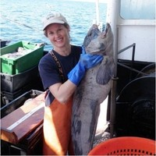
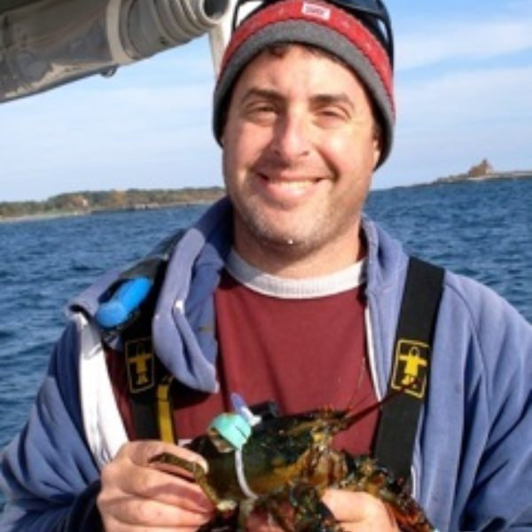
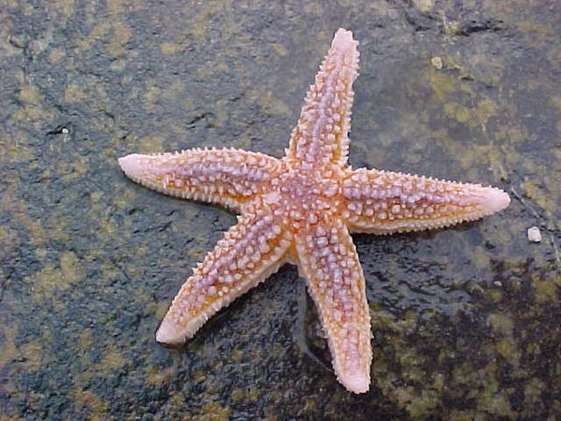
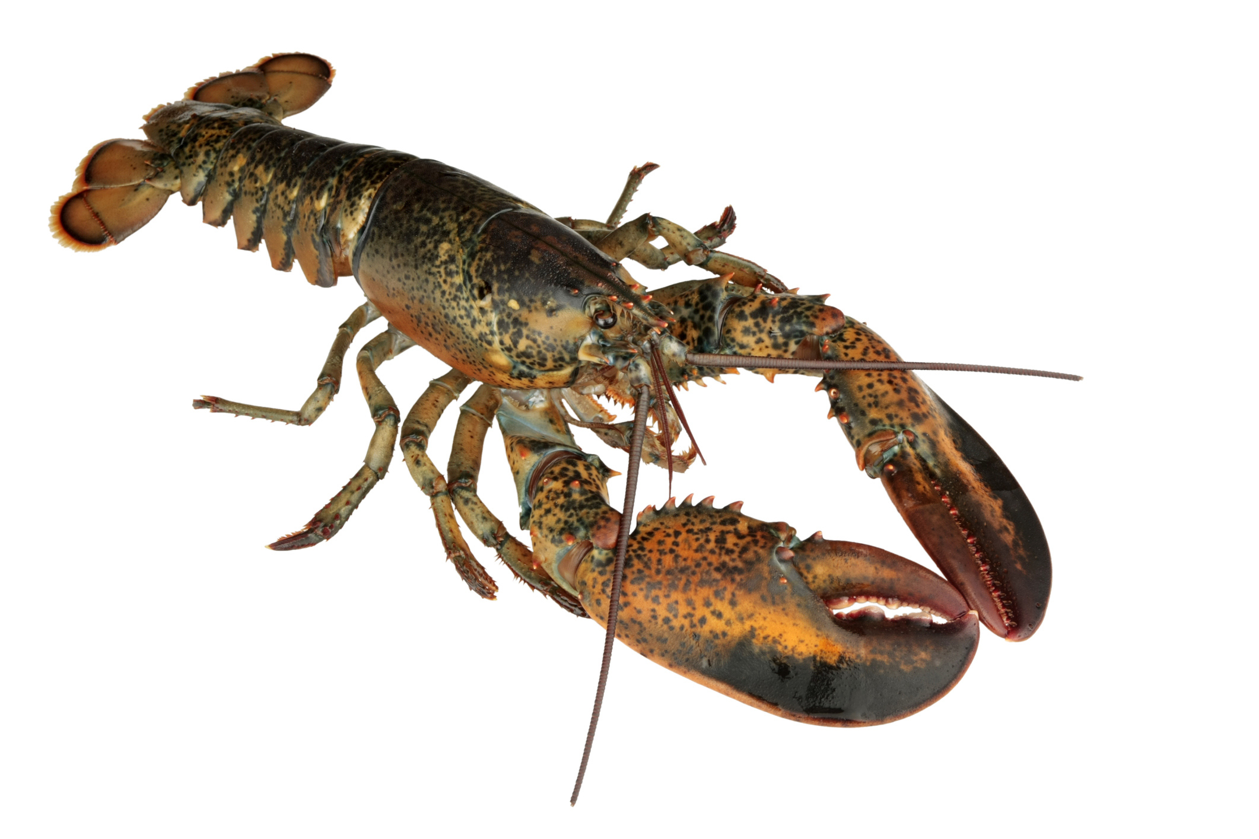
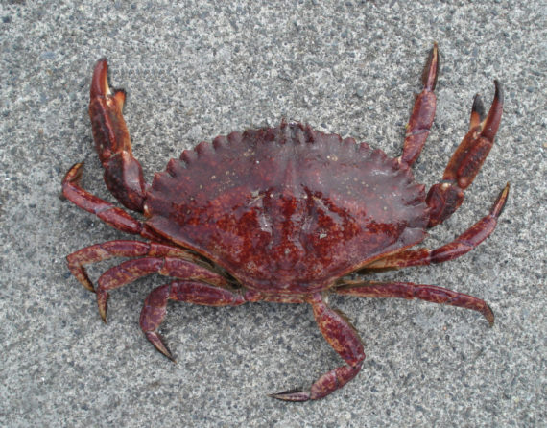
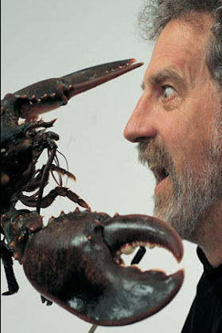
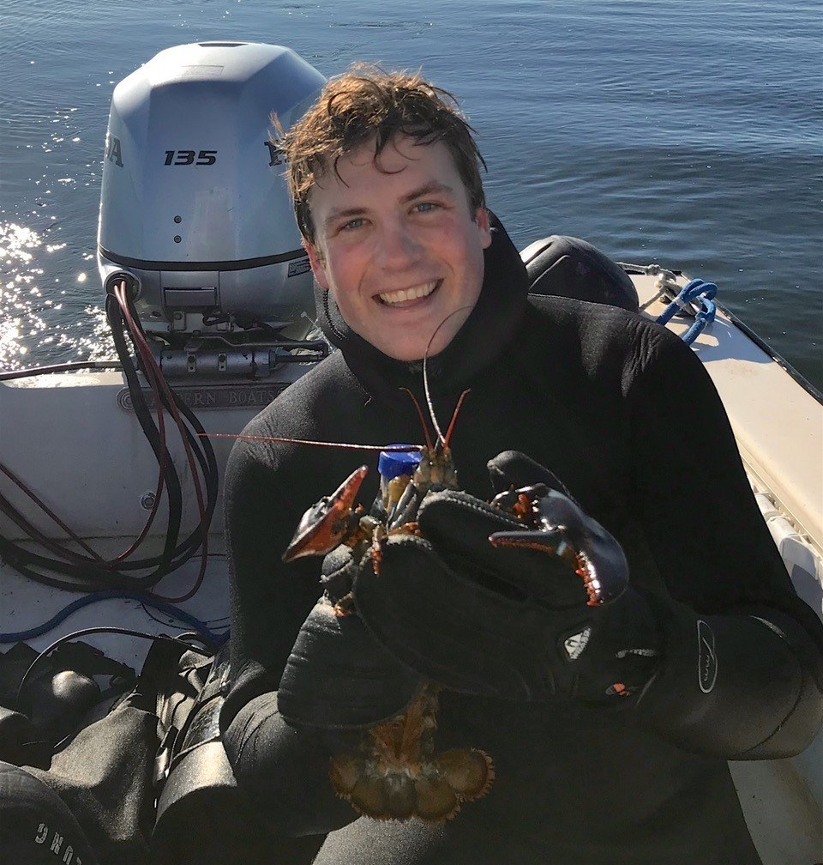
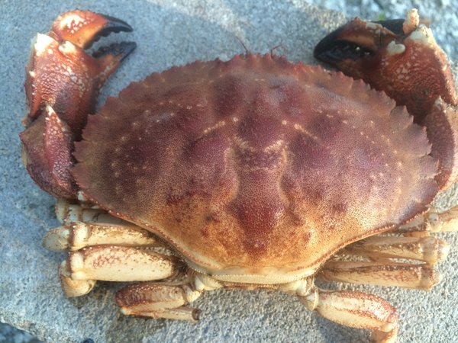
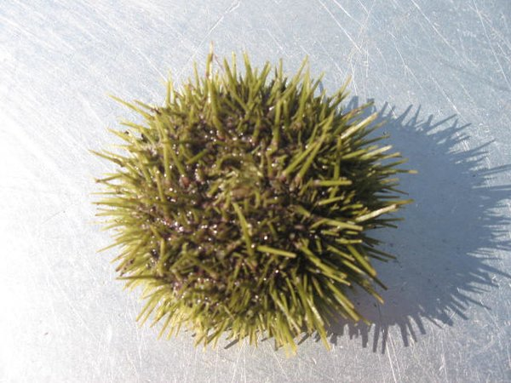
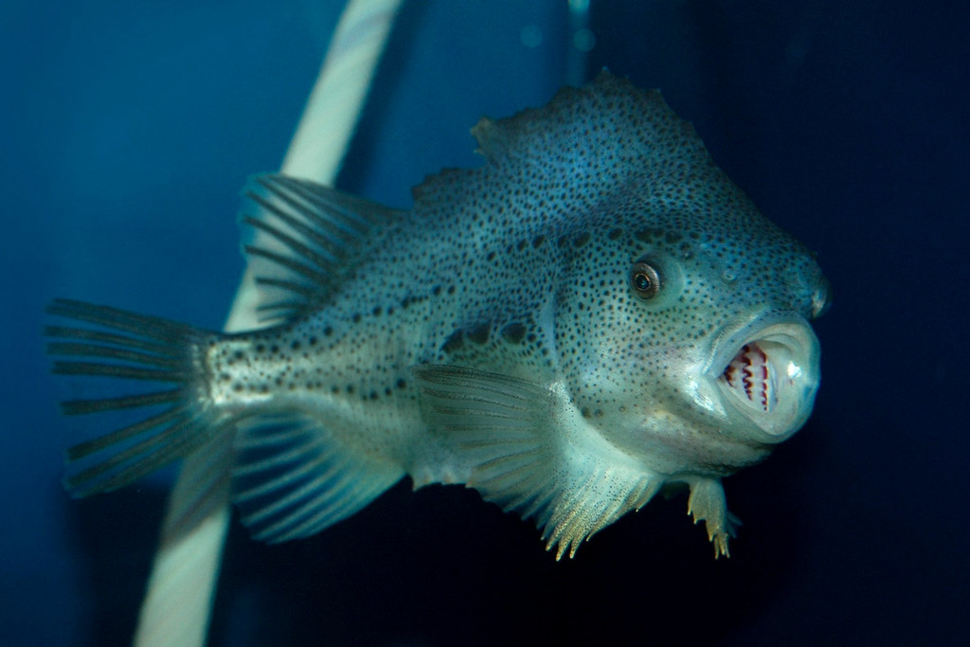
Featured Creatures and scientists

Slide 6

The Process
Keep It Simple Silly
Answer questions (TikTok has a great feature for this)
Keep viewers engaged (visually and through interaction)
Do what works (but don’t beat a dead horse)
Know your audience
  Keep language understandable
  Make content silly and funny
  Make content relatable
If you find something interesting, then others will too!

Slide 7
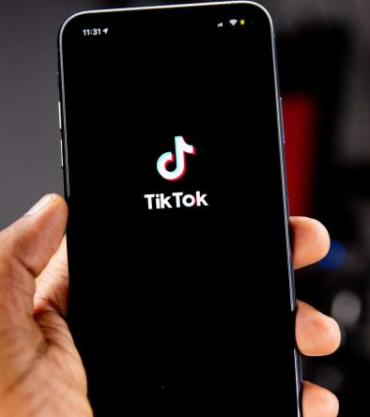
Tiktok as a media for science
TikTok is available in over 150 countries with over 1 BILLION users
TikTok is the fastest growing social media platform ever
In the last 60 days → 21.3M video views
1000s of questions everyday
  “How do I do what you do?”
  “Why do lumpfish stick to things?”
  “How do you gender a crab?”
  “Where did you go to school?”
  “What’s your degree in?”

Slide 8
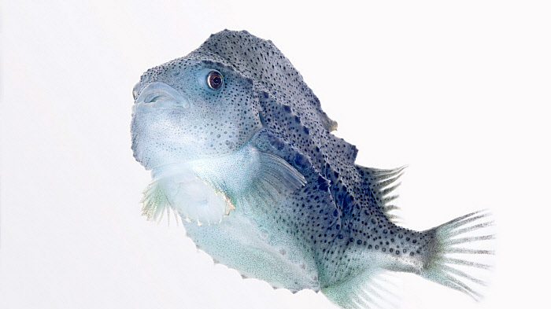
Create to inspire!
Nathaniel Spada
TikTok: @Spadaniel44
Email: nns1003@wildcats.unh.edu

